Slide 1
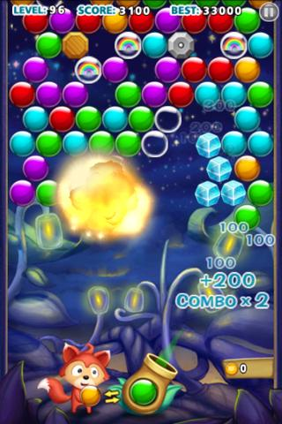
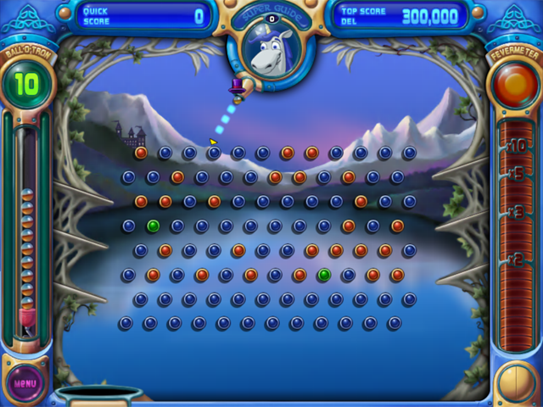
BouncE – A puzzle game

Slide 2
What is new
As many bounces as possible
Balls have abilities
Red – Increase gravity
Blue – Lower gravity for 5 seconds
Pink and white – manually reset the ball anywhere you want
Orange – lower the score
Black – standard point increase
Purple star – score increase

Slide 3
Rules
You can fire three balls
Once you hit the true bottom of the screen and have no balls left, play is over
Each time you hit a ball, it changes colour

Slide 4

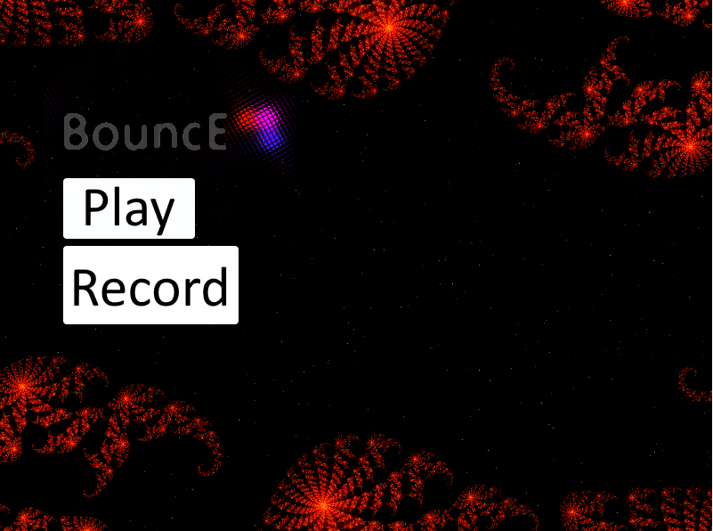
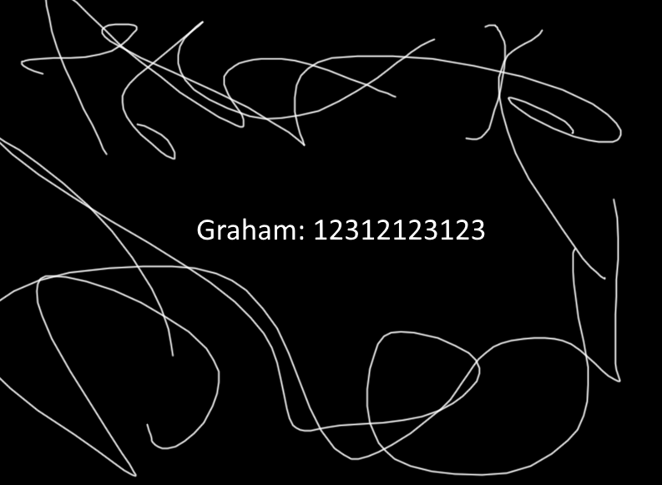
Init → Menu→ Score → Menu

Slide 5
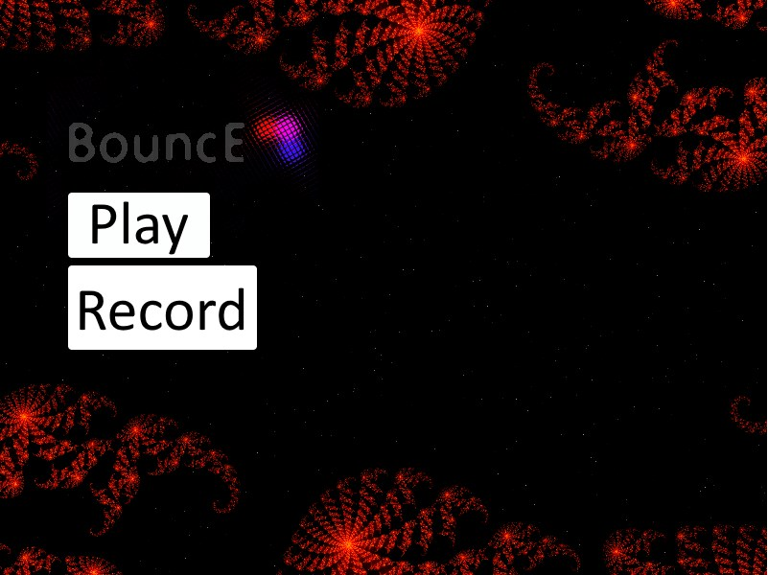
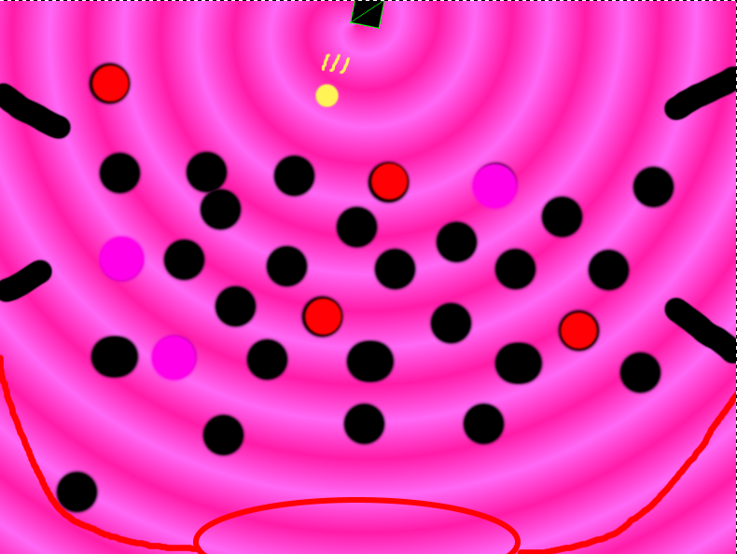
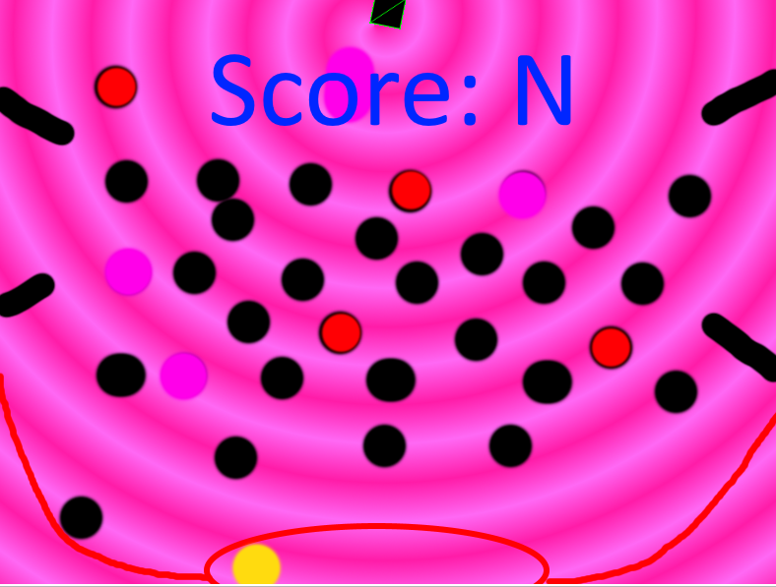
Init → Menu → Setup → Play → Score → Menu

Slide 6
Focus
Heavy focus on collision detection and physics
Many different combinations and outcomes on collision between the varying balls and environmental objects

